Slide 1
Object-Oriented Programming Using Java
Interface and Abstract Class

Slide 2
Contents
Defining an Interface
Implementing an Interface
Abstract Methods and Classes
References: https://docs.oracle.com/javase/tutorial/java/IandI/createinterface.html
https://docs.oracle.com/javase/tutorial/java/IandI/abstract.html

Slide 3
Interface
Interface is a reference type (kiểu dữ liệu tham khảo), similar to a class
Interface can contain only
  constants,
  method signatures,
  abstract methods,
  default methods,
  static methods,
  and nested types

Slide 4
Defining an Interface
public interface InterfaceShape {
//All constant values are implicitly public, static, and final.
//you can omit these modifiers.
double PI = 3.14;
public static final double E = 2.71;
double calculateArea(); // method signatures
abstract double calculatePerimeter(); // abstract methods
//Only default and static methods have implementations
static double sqr(double x){ // static methods
return x*x;
}
//if you want to add new functionality to the interface, using default methods
default void doSomething(String s){ // default methods
//do something here
}
//All methods in an interface are implicitly public,
//you can omit the public modifier.
}

Slide 5
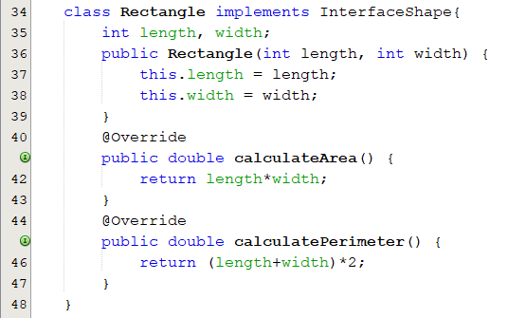
Implementing an Interface

Slide 6
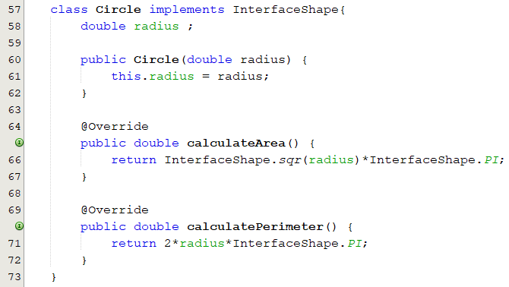
Implementing an Interface

Slide 7
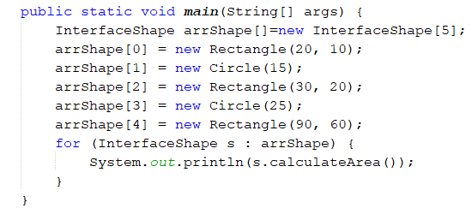
Implementing an Interface

Slide 8
Abstract Classes
An abstract class is a class that is declared abstract
It may or may not include abstract methods.
Abstract classes cannot be instantiated, but they can be subclassed.

Slide 9
Abstract Classes
abstract class GraphicObject {
int x, y; // fields
void moveTo(int newX, int newY){ // non-abstract methods
x = newX;
y = newY;
}
abstract void draw(); // abstract methods
abstract void resize();
}
// Implement all abstract methods
class Rectangle extends GraphicObject {
@Override
void draw() { //code here }
void resize() { //code here }
}

Slide 10
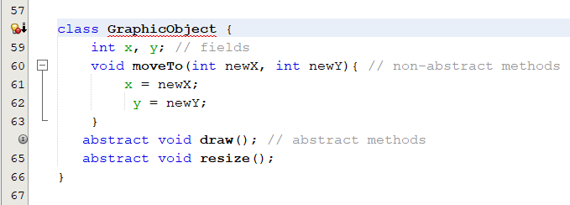
Abstract Classes
If a class includes abstract methods, then the class itself must be declared abstract

Slide 11
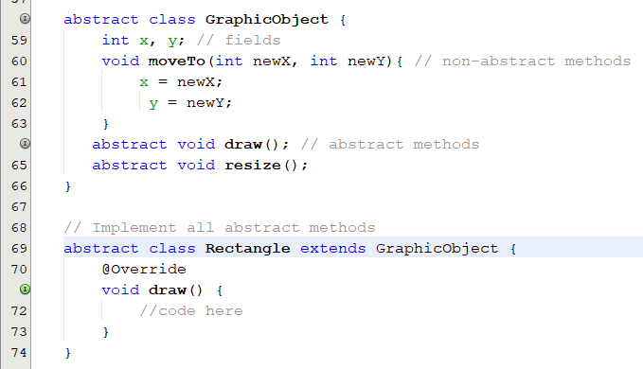
Abstract Classes
If subclass does not implement all abstract methods of superclass then the subclass must also be declared abstract.

Slide 12
Abstract Class Implements an Interface
class X must be abstract
abstract class X implements Y {
// implements all but one method of Y
}
class XX extends X {
// implements the remaining method in Y
}

Slide 13
Abstract Classes Compared to Interfaces
Can not instantiate abstract class and interface
With interfaces, all fields are automatically public, static, and final, all methods are public.
A class can extend only one class, and implement any number of interfaces.

Slide 14
Test 1
public interface Document {
String name = "Document1";
String getExtension();
public static void main(String[] args) {
Document doc1 = new Document();
System.out.println(doc1.name);
}
}
a) Document1
b) Compile-time error
c) Run-time error
d) Nothing
Notes:
Không thể tạo đối tượng từ interface

Slide 15
Test 2
public interface Document {
String name = "Document1";
void output(){
System.out.println(name);
}
String getExtension();
public static void main(String[] args) {
Document doc1 = new Document();
doc1.output();
}
}
a) Document1
b) Compile-time error
c) Run-time error
d) Nothing
Notes:
Interface không chứa phương thức có implementation

Slide 16
Test 3
public interface Document {
String name = "Document1";
void output();
String getExtension();
public static void main(String[] args) {
Document doc1 = new Word();
doc1.output();
}
}
class Word implements Document{
String name; double size;
void output() {
System.out.println(Document.name + size);
}
String getExtension() {
return "docx";
}
}
a) Document10
b) Compile-time error
c) Run-time error
d) Document10.0
Notes:
Các hàm implement trong lớp con phải khai báo public

Slide 17
Test 4
abstract class Document {
String name;
double size;
void input(){
name = "Test";
size = 12.5;
}
void output() {
System.out.println(name + size);
}
public static void main(String[] args) {
Document doc1 = new Document();
doc1.input();
doc1.output();
}
}
a)Test12.5
b) Compile-time error
c) Run-time error
d) null
Notes:
Không thể tạo đối tượng từ Abstract class

Slide 18
Test 5
public interface Document {
void create();
void save();
public static void main(String[] args) {
Document doc1 = new Word();
doc1.save();
}
}
abstract class DWord implements Document{
String name;
double size;
public void create(){
name = "DWord1";
size=0;
}
}
class Word extends DWord{
public void save() {
System.out.println("Save "+ name +" successfully!");
}
}
a) Save null successfully!
b) Compile-time error
c) Run-time error
d) Save DWord1 successfully!
Notes:
Không thể tạo đối tượng từ Abstract class

Slide 19
Test 6
public abstract class Document {
abstract protected void create();
abstract void save();
public static void main(String[] args) {
Document doc1 = new Word();
doc1.save();
}
}
abstract class DWord extends Document{
String name;
double size;
protected void create(){
name = "DWord1";
size=0;
}
}
class Word extends DWord{
void save() {
System.out.println("Save "+ name +" successfully!");
}
}
a) Save null successfully!
b) Compile-time error
c) Run-time error
d) Save DWord1 successfully!
Notes:
Không thể tạo đối tượng từ Abstract class

Slide 20

Q&A

